Slide 1
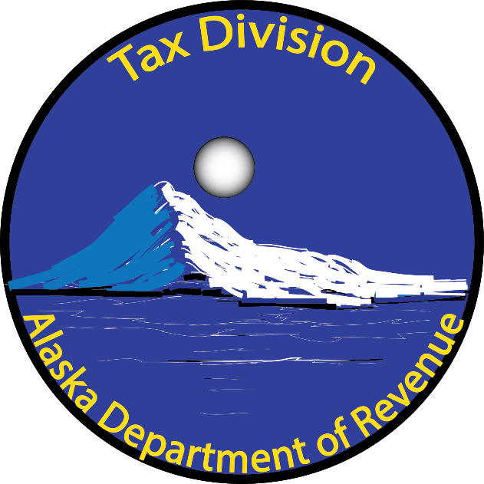
An Overview of
State Marijuana Taxes
Presented by:
Kelly Mazzei
Excise Tax Supervisor
Alaska Tax Division
June 10, 2020

Slide 2
Presentation Topics
Current State Tax Structure
The Taxpayers
Tax Revenue
Past Due Taxes
Collections Process
Tax Division Resources

Slide 3
State Tax Structure
Cultivators pay the tax on sales and transfers
Excise tax is $50, $25, or $15 per ounce
Tax returns and payments due monthly on the last day of the month following the month of sales (30-60 days after sales)
If tax payments are not paid, the cultivator could have license revoked under AS 17.38 (AMCO)
DOR will inform AMCO of failure to pay tax due or file returns (in regs)

Slide 4
The Taxpayers
There are 217 active operating cultivator licenses (AMCO)
There are 198 open marijuana tax accounts (DOR)
There are 24 cult. licenses expired or surrendered
Newly licensed cultivators get a “Welcome Packet” using AMCO’s licensing spreadsheets
Cover letter, cash payment instructions, and Revenue Online information
Tax employee calls every new cultivator to help

Slide 5
Marijuana Tax Revenue (by month)

Slide 6
Marijuana Tax Revenue (by FY)

Slide 7
Past Due Taxes – The Numbers
29 cultivators owe past due taxes $1,340,000
20 cultivators are on payment plans $1,012,000
8 payment plans are past due owing $354,000
5 cultivators out of business owing $313,000
6 cultivators have not paid taxes for 9 months or more in a 12 month period (March – Feb 2020)

Slide 8
The Collections Process
Files tax return but no payment or short paid
Fully automated process begins
Notice of Demand for Payment mails 10 days after due date
Appeal period begins – 60 days to appeal or pay
Final Determination letter mails 15 days after appeal period ends (85 days late)
Accounting and Collections unit is notified 15 days after FD letter (100 days late)

Slide 9
What Happens When Taxes Aren’t Paid?
Alaska Statutes 43.61.030(b)
If a marijuana cultivation facility fails to pay the tax to the state, the marijuana facility’s registration may be revoked in accordance with procedures established under AS 17.38.190(a)(1)
As written in the General Election Ballot Measure No. 2

Slide 10
What Happens When Taxes Aren’t Paid?
Alaska Regulations 15 AAC 61.020
The DOR will inform the MCB of failure to pay tax due or file a return as required to initiate a license suspension or revocation proceedings
As written in the regulations

Slide 11
Notifying AMCO – Monthly Letter
Pursuant to Alaska Statutes and Regulations, AS 43.61.030 and 15 AAC 61.020, the Department of Revenue will inform the Marijuana Control Board of licensed cultivators that have failed to pay tax due or file a return as required by law.
As of June 5, 2020, there were 10 licensed cultivation facilities that failed to pay marijuana excise taxes as required under AS 43.61.010. The list does not include accounts that are compliant on payment plans or out of business. It also does not include accounts that have past due balances under $200. If we reported the total number of past due accounts for tax periods through January 2020, we would report 29 licensed cultivators owing a total of $1,340,000.

Slide 12
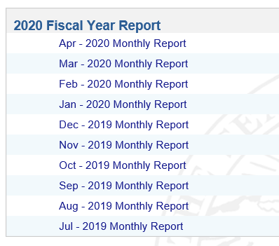
Tax Division Resources - Reports
http://tax.alaska.gov/

Slide 13
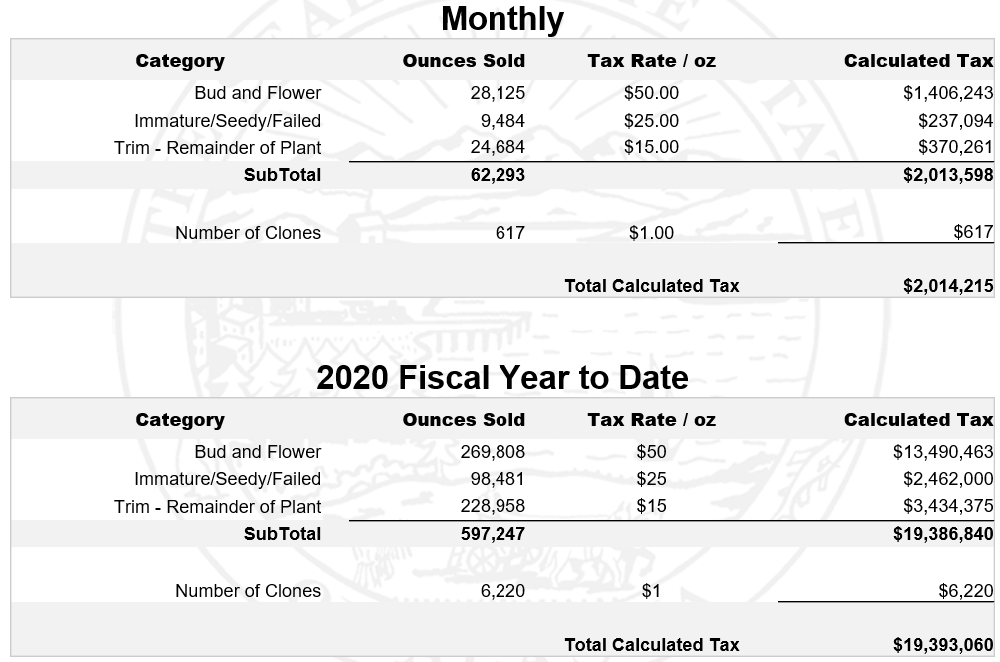
Tax Division Resources - Reports

Slide 14
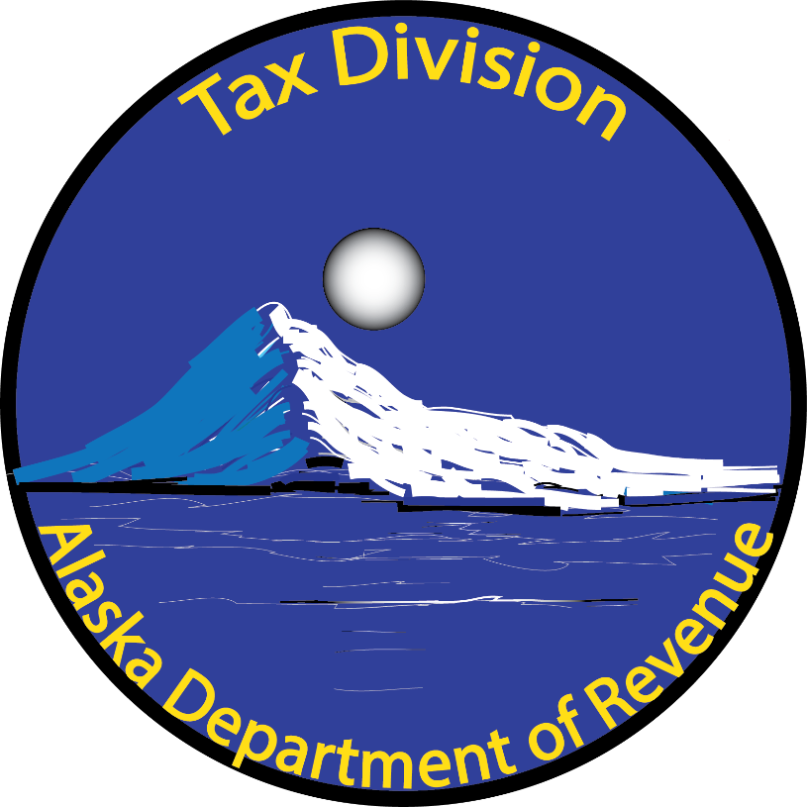
Presentation Contact - Marijuana
State of Alaska
Tax Division
Kelly Mazzei
Excise Tax Supervisor
907-269-1018
kelly.mazzei@alaska.gov

